Slide 1
Master Discussion
14.05.2018
Malvik & Witzøe

Slide 2
Contents
New Recourse Model
New Scenario Generation Model

Slide 3
New Recourse Model
As noted by Bjarne, changes are implemented step-wise
The system is allowed to reach a «steady-state» after implementing each change
This is akin to «observing» the scenario for the well we change, i.e. actual gas and oil rates
If a change leads to infeasibility it is rolled back, but we now have information on the true behavior for the well we changed

Slide 4
Recourse Algorithm
Assume scenario generation using variance constants. Assume robust optimization with a set S of scenarios.
The following strategy is used:
Choose current solution = starting scenario where x/7 wells are producing with known scenario constants stored in the set K.
Choose n = initial maximum changes available
Then, while n>0, do:
Optimize robust model with S scenarios, maximum n changes from current solution and known constants K
Choose one well w to implement suggested change on by ordering wells greedily by Gas-Oil-Ratio, but prioritize negative choke changes first
Draw a scenario constant A_{w} for well we wish to change (note: not drawn from S)
If new choke setting for w under A_{w} is feasible:
Current solution ← new solution
Else:
Current solution unchanged
K = K ∪ {A_{w}}
n = n-1

Slide 5
Recourse Algorithm
As we implement changes, we learn the true scenario constants for the changed wells
For each run, we record the objective values attained and if infeasibility occured during any of the steps
For different robust optimization scenario set sizes, the algorithm was repeated 200 times
We then compare this to the EEV

Slide 6
Recourse Algorithm - Results

Slide 7
Recourse Algorithm – Discussion Points
For wells that are already producing, we assume we know the entire scenario distribution. In reality, we only know what our scenario looks like for the current choke setting

Slide 8
New Scenario Generation Model
We desire the following properties in a scenario generation procedure:
The scenario curve should be able to intersect a given (choke, output) point if specified, since we know our current production rate for wells that are already producing (but are uncertain about choke values)
The scenario curve should be able to vary around the mean more freely than the constant variance term draw

Slide 9
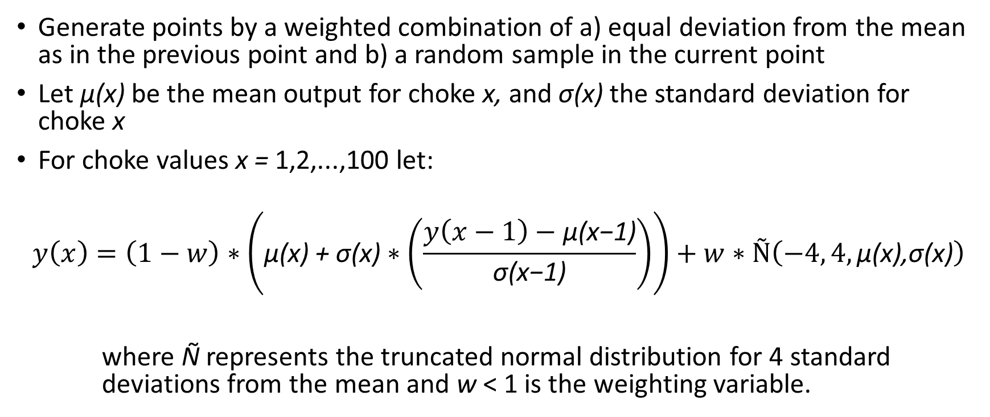
New Scenario Generation Model
Generate points by a weighted combination of a) equal deviation from the mean as in the previous point and b) a random sample in the current point
Let μ(x) be the mean output for choke x, and σ(x) the standard deviation for choke x
For choke values x = 1,2,...,100 let:
$$y\left(x\right)=\left(1−w\right)∗\left(\text{μ}\text{(}\text{x}\text{) + }\text{σ}\text{(}\text{x}\text{)}∗\left(\frac{y\left(x−1\right)−\text{μ}\text{(}\text{x}\text{−1}\text{)}}{\text{σ}\text{(}\text{x}\text{−1}\text{)}}\right)\right)+w∗Ñ\left(−4, 4,\text{μ}\text{(}\text{x}\text{),}\text{σ}\text{(}\text{x}\text{)}\right)$$
where Ñ represents the truncated normal distribution for 4 standard deviations from the mean and w < 1 is the weighting variable.

Slide 10
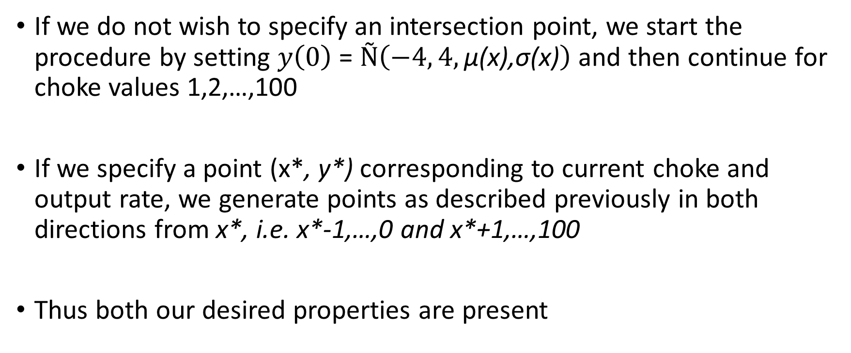
New Scenario Generation Model
If we do not wish to specify an intersection point, we start the procedure by setting $y\left(0\right)$ = $Ñ\left(−4, 4,\text{μ}\text{(}\text{x}\text{),}\text{σ}\text{(}\text{x}\text{)}\right)$ and then continue for choke values 1,2,…,100
If we specify a point (x*, y*) corresponding to current choke and output rate, we generate points as described previously in both directions from x*, i.e. x*-1,…,0 and x*+1,…,100
Thus both our desired properties are present

Slide 11
Scenario Generation Model - Results

Slide 12
Scenario Generation Model – Discussion Points
It is still necessary to train new networks to apply the new scenario generation procedure. Probably quickly becomes intractable
Alternatively, one may use SOS2. This will however scale very poorly with higher dimensional inputs
Possible approach: Feasibility study, how does solution time scale with number of scenarios?

